Slide 1
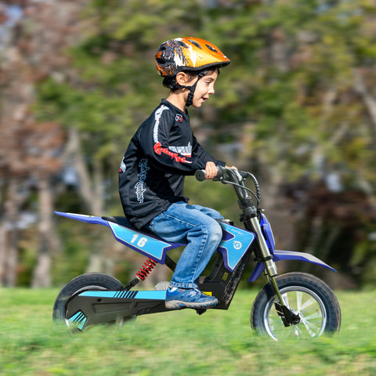
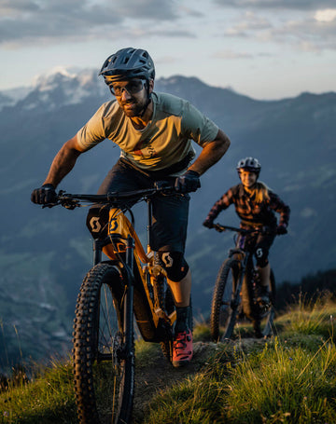
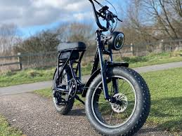
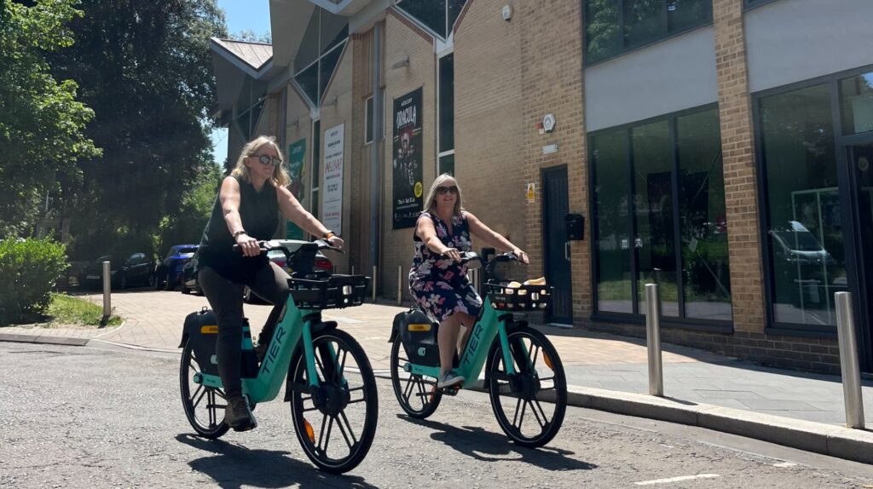
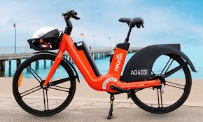
Electrical Safety: E bikes

Slide 2
Electric bikes are an increasingly popular mode of transport across the UK. Do you know anyone who owns an electric bike?

Slide 6
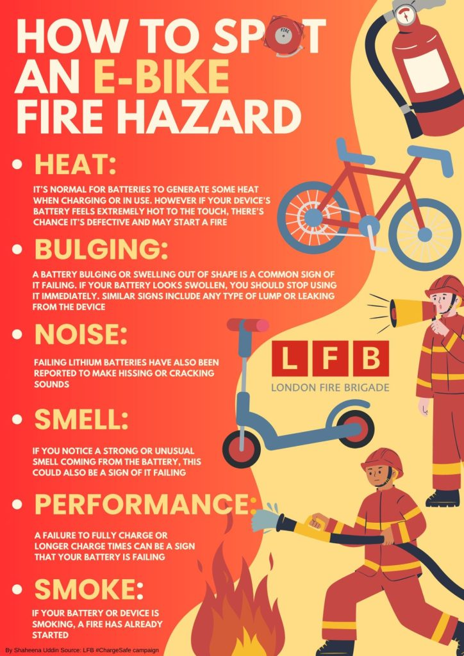

Slide 7
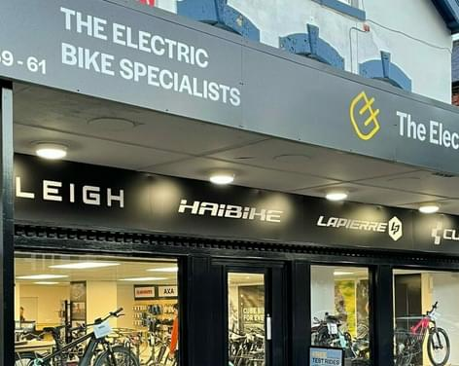

Slide 8
This activity was produced by Schoolzone on behalf of Electrical Safety First, the UK's leading charity working to keep families safe when using electricity at home.
Visit our Switched On Kids website for more.

