Slide 1
Battery Safety Squad
Activity 3 Learning Objective
To present practical battery charging safety advice to others

Slide 2
Let’s review everything we have learnt about safe lithium battery charging and the dangers of this technology

Slide 3
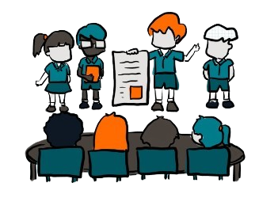
Challenge!
Now it is time to spread the word!
We want our school community to know these important safety measures too.
You are going to prepare a presentation to share with the rest of the school
You must clearly share all the safety information you have learnt.

Slide 4
Challenge!
Preparing your presentation
Know Your Audience: Think about the range of ages. Make sure your communication is suitable for them.
Organise Your Content:
Break your presentation into three parts: an introduction, main points, conclusion.
Understand the topic well:
Review information we have gathered and research more if you need to.
Create Visual Aids: Use posters, slides, or props to help explain your points.

Slide 5
Challenge!
Rehearsing your presentation
Practice with Visual Aids:
Practice with props or slides so you know when to show them
Work on Your Voice: Speak clearly and loudly enough for everyone to hear.
Practice Body Language: Stand up straight, make eye contact and use gestures to emphasise points.
Time Yourself:
Make sure your presentation is not too long or too short.

Slide 6
Challenge!
Presenting to your peers
Engage Your Audience:
Give them an opportunity to ask questions or ask them what they might do with the advice?
Speak clearly and at a good pace:
Don’t rush. Speak slowly enough that everyone can understand
You are the experts:
Everyone is here to hear from you. Be confident. You know the information, so share it confidently.
Handle Mistakes Gracefully:
If you make a mistake, don’t worry! Take a deep breath and continue.

Slide 7
What feedback did we get from the rest of the school after our presentations?
How did you feel during your presentation. Were there parts that were challenging? What went well?
Evaluating our presentations
What would we improve if we did this again?

Slide 8
This activity was produced by Schoolzone on behalf of Electrical Safety First, the UK's leading charity working to keep families safe when using electricity at home.
Visit our Switched On Kids website for more.

